Slide 1
MindFul
You are not alone ☺
MAYANK GUPTA (mg66426)
RACHANA AITHAL (RA39563)
RAHULL BORANA (RB47374)
SAIYAM SHAH (sns3694)
SANJANA NAYAK (svn378)

Slide 2
1 in every 8 people in the world live with a mental disorder
Problem Statement & Motivation (1/2)
The majority of suicides worldwide are related to mental health disorders; depression, substance use, and psychosis
The World Health Organization (WHO) reports that suicide is one of the leading causes of death among individuals aged 15-19

Slide 3
OUTLINE
01
04
Problem Statement & Motivation
Analysis & Results
05
Data-Source & Preprocessing
Takeaways & Future Scope
06
01
02
02
03
Methodology
Q&A

Slide 4
Problem Statement & Motivation (2/2)
Our Idea: Build a mental health recommendation system offering personalized advice derived from shared community experiences of like-minded people by leveraging text analytics, NLP and LLM.
Like-Minded People
Reduced-Stress
Emotional Wellbeing
Belongingness

Slide 5
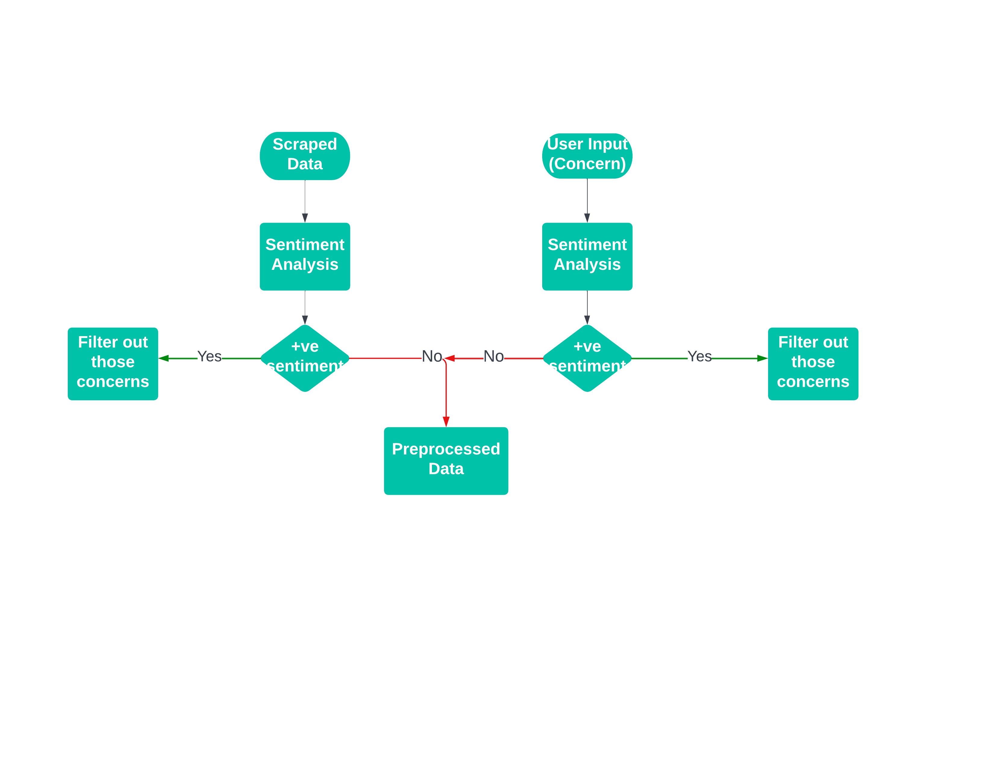
Dataset & Preprocessing
Data Source: HealthUnlocked (world’s largest social network for health)
Tag | Specific mental disorder
Concern | Specific concern related to the disorder
Suggestion | Recommendations/Suggestions/Advice provided

Slide 6
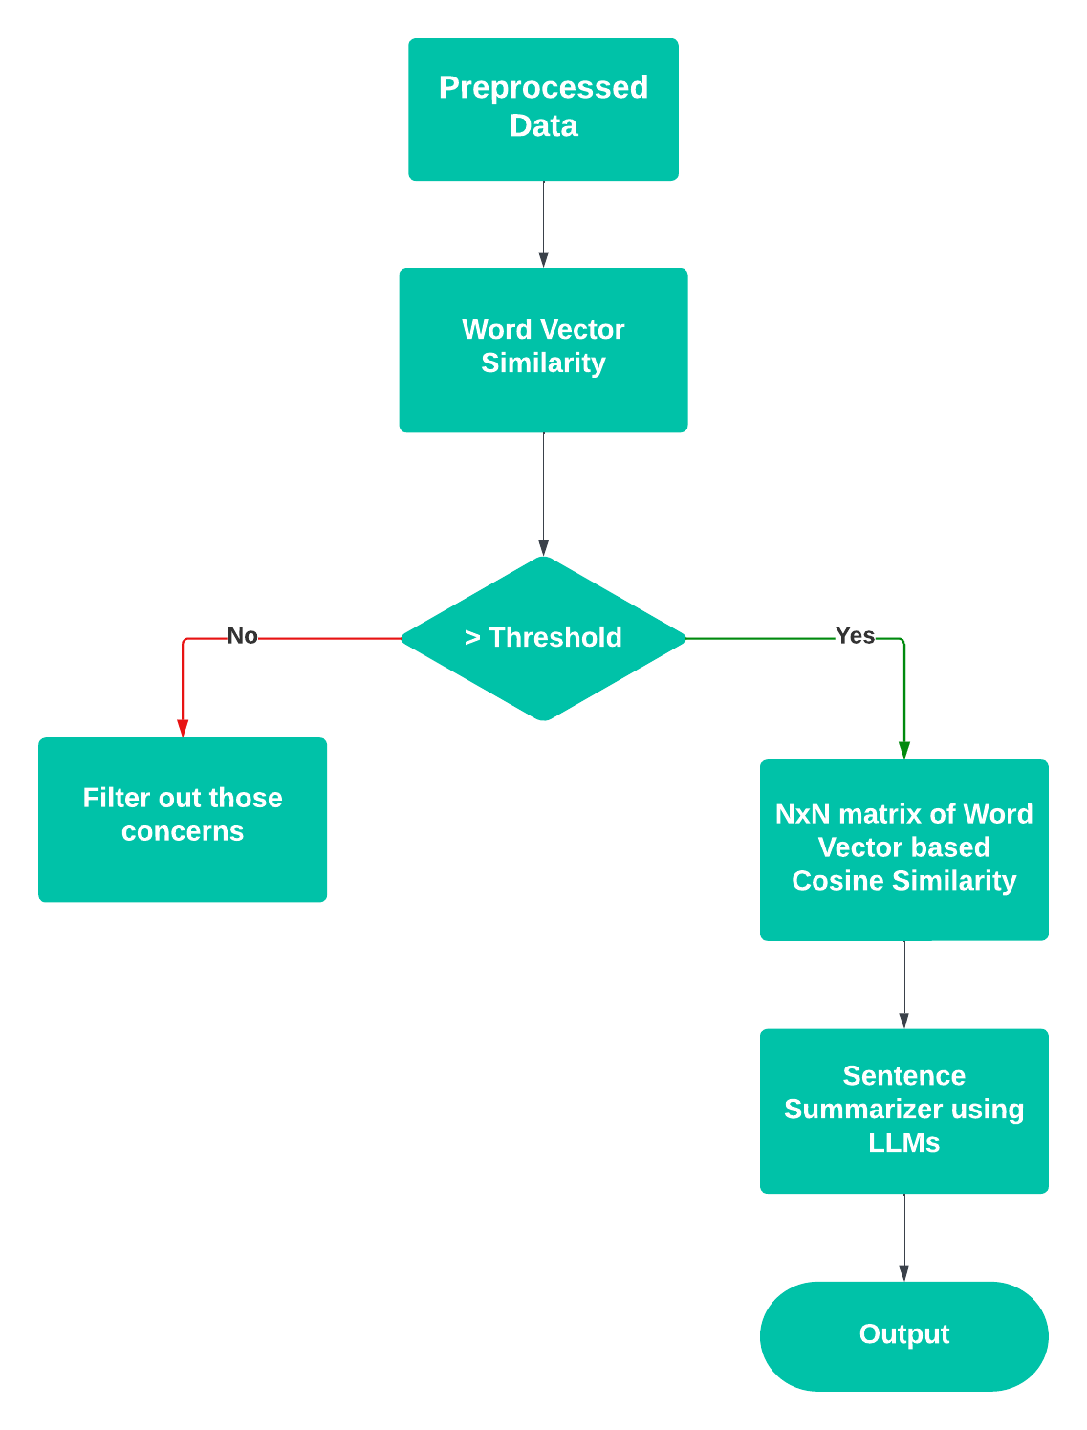

Slide 7
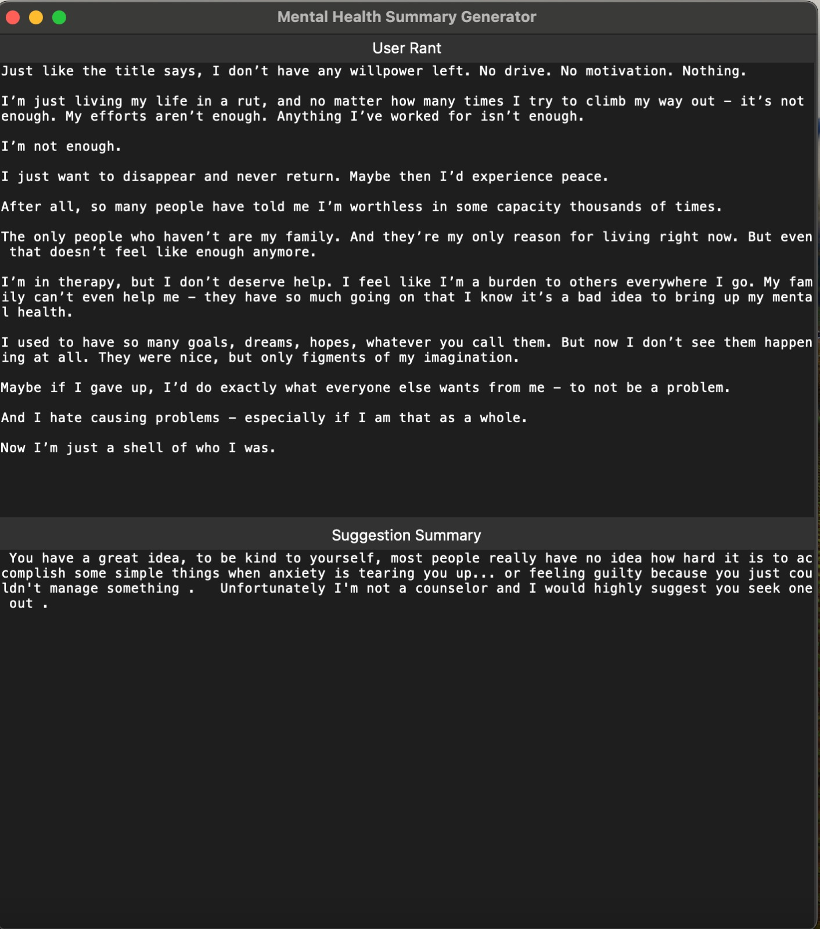
Analysis & Results (1/2)

Slide 8
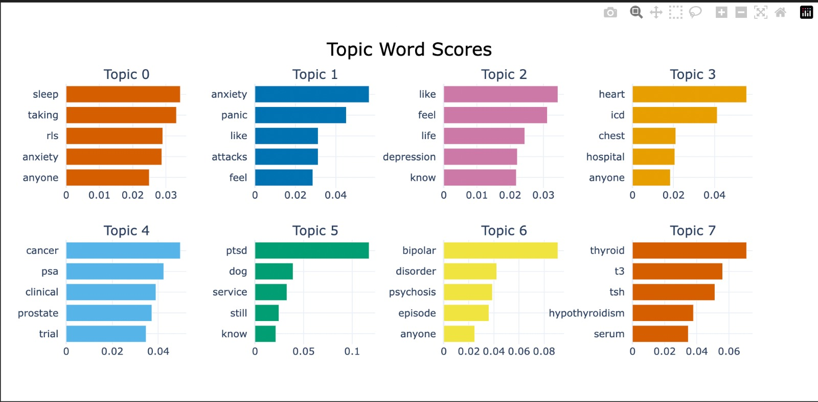
Analysis & Results (2/2)

Slide 9



Key Takeaways & Future Scope
Personalization
Community Support
Safe-Space
Expand to include additional mental health disorders to reach a wider range of individuals
Foster a supportive online community where individuals can share experiences and receive peer support
Create a user-friendly website or app for improved accessibility and engagement

Slide 10
Questions ???
Thankyou!!!

